Slide 1
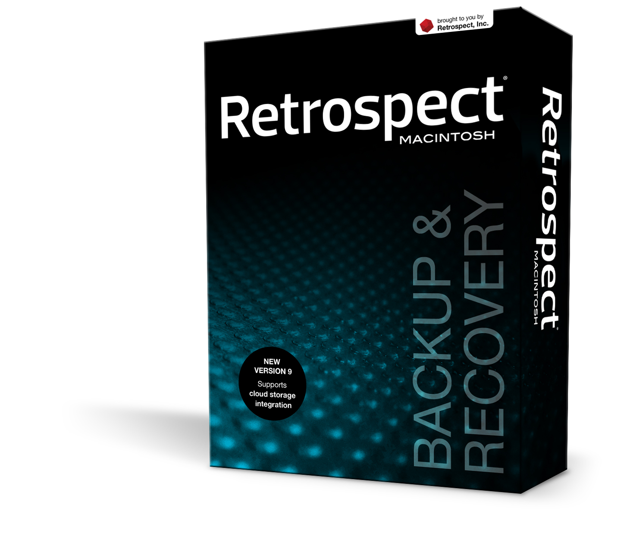

Retrospect
for Mac & Win

Slide 2
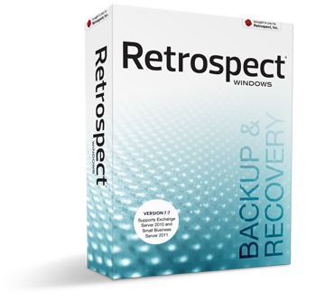
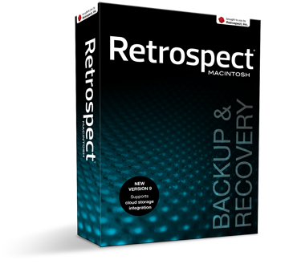
Retrospect protects millions of computers world-wide
Retrospect provides easy-to-manage, automated, reliable data protection for:
Servers, Desktops and Notebooks
Mac, Windows, Linux, Solaris, NetWare
Mixed heterogeneous environments
Small and Medium Businesses (SMB)
Companies from 5-500 users
Small Offices and Home Offices (SOHO)
1-5 Users
The Distributed Enterprise
remote/branch offices, workgroups
Government and Education
Similar size to SMBs

Slide 3
Solves Customer Challenges
High cost of data loss - business is vulnerable
  Backup process is inadequate, unreliable, inconsistent
Rapid data growth, rising access demands
  Need faster restores, faster backups
  Taking applications/users offline not acceptable
Microsoft Exchange and SQL Server
  Critical to business
Vulnerable to disaster (fire, water, storm, system failure…)
  No offsite copies
  Rebuilding computers takes several hours, days
Compliance, data security
  Unencrypted backups expose sensitive information; costly ramifications if lost or stolen
Limited IT resources and lean budgets – In these economic times
  Need robust protection without complexity and high price tag

Slide 4
Market Leadership
Designed for SMBs and SOHO environments
  25 years of innovation and reliability
  Hosted on Windows and Macintosh Platforms
Protects millions of computers worldwide
  Editions for individual users to large networks
  Localized in English, French, Spanish, German, Japanese, Italian, Chinese (Simplified & Traditional), Brazilian Portuguese, Korean and Russian
  Retrospect Express version OEM’d by 30+ storage vendors
Wins over Symantec Backup Exec, CA ARCserve, Acronis and Bakbone’s NetVault for Macintosh

Slide 5
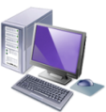







Retrospect Customer Profiles
Small and Medium Businesses (SMB), Government, Education
  ≤ $250M annual revenue
  ≤ 500 employees
  Limited IT resources (often 0-2 or outsourced)
  Key apps: Exchange, MS SQL, Access, Peachtree, Great Plains, QuickBooks
  Other key apps by vertical (patient records, design, CRM, Web, etc)
Distributed Enterprise
  Desktops and notebooks; work groups, branch/remote offices
Small Office/Home Office (SOHO)
  Remote workers; digital home
  Heterogeneous (Win/Mac) Environments
60% of data resides here - IDC

Slide 6







Complete Protection for Critical Data
Disk
Retrospect
Backup Server
App Server
Exchange
Server
MS SQL
Server
File
Server
Tape
SCSI, iSCSI, or FC
CD/DVD
Backup data
Networked Systems – Retrospect Business Editions
Rev
Choose a Windows or Macintosh Backup Server
Protect Servers, Desktops, Notebooks, 24x7 Applications
  Per backup server: up to 15 servers, 300 desktops/notebooks, millions of files per volume
  Windows, Red Hat Linux, SUSE Linux, Novell Linux, Mac OS X, Solaris, NetWare, VM machines
  MS Exchange 2007, MS SQL Server; Open File Protection
  Individual Systems – Retrospect SOHO Edition
  Protect Windows and Mac desktops or notebooks individually
Notes:
6

Slide 7
Key Retrospect Technologies
Smart Incremental technology eliminates need for full backups
Self-adjusting “Proactive” backups maximize resources
Powerful & Flexible
Supports disk, NAS, WebDAV cloud storage, tape drives & libraries, and flash drives
Protects Mac, Windows, and Linux computers
Reliable & Secure
Perfect point-in-time restores every time, from individual files to entire volumes
Easily maintains multiple, independent backup destinations for added reliability
Automated disk grooming removes outdated files
File-level deduplication saves time and storage space
Automatic client detection and login ensures protection
Remote management of multiple Retrospect servers
Easy & Automatic
Performs up to 16 simultaneous operations
Multiple levels of encryption protect backed-up data and ensure secure network communication
Retrospect is built on more than two decades of Mac OS storage and networking expertise

Slide 8
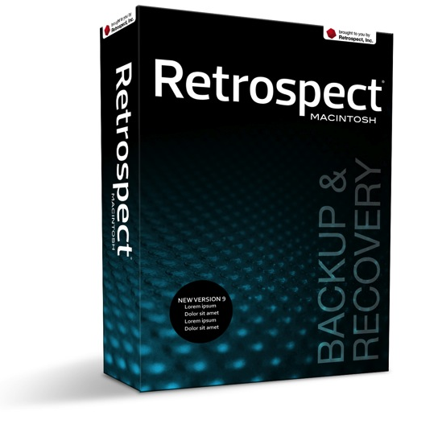
Retrospect 9: Reliable, Secure, Proven
Retrospect for Mac provides…
Complete backup and recovery for Mac-only and mixed Mac/Win/Linux networks
Enterprise-class features, performance, and device support that SMBs need, without requiring dedicated IT staff to manage
Reliable, point-in-time restores that are perfect every time
A state-of-the-art Mac user interface that’s easy to navigate and operate

Slide 9
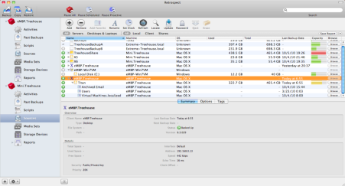
New Features in Retrospect 9
WebDAV cloud storage support provides easy off-site backups
All-new Retrospect Client software for Intel Macs with on-demand backup and restore
Support for Mac OS X Lion
Additional wake-on-LAN options promote energy conservation
Ability to upgrade remote Retrospect servers over the LAN/WAN
Improved stability and user experience

Slide 10
WebDAV Cloud Storage Support
Access to storage via standard WebDAV protocol
  WebDAV is built into modern operating systems and easy to configure
  Communicates via HTTP port 80, which streamlines configuration and compatibility—no need to configure routers or firewalls
  More secure and better performing than older versions’ support for FTP
Complements local disk backup by providing easy offsite storage
Allows for “private cloud” storage providing offsite backup services
Also allows backup to services like Amazon S3 and Apple MobileMe
Backups to WebDAV storage can be set to exclude unnecessary data, such as operating system and application files
Common strategy: Daily backups to local disk, weekly copies of critical data to WebDAV cloud storage

Slide 11
New Retrospect 9 Client Software
All-new client for Intel Macs
Employs a proper System Preference pane and menu bar extra
Full 64-bit support improves performance and memory usage
Provides better feedback to the user
  Growl notifications of certain backup operations
  Animated menu bar icon with status
Allows users to initiate on-demand backups and restores
Administrator sets options for level of allowable user interaction
Supports AES-256 encryption between clients and server

Slide 12

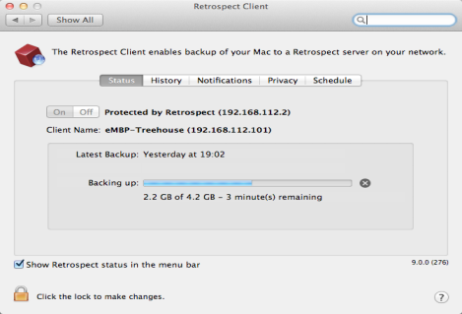
Components of the New Retrospect 9 Client
Use the History tab to select files for restore*
Activate Growl notifications and S.M.A.R.T. disk health reporting
The Retrospect administrator can prevent the Client from being turned off
The menu bar extra also provides useful info
Define volumes, folders, and files as private*
Details area shows the current activity or time and date info for the last and next scheduled backup
Protection status and network info for server and client
A progress bar provides visual feedback and a button to stop the backup*
Option to show or hide the Retrospect status menu

Slide 13
Retrospect vs. Time Machine
Retrospect
Retrospect manages backups of multiple Macs to centralized storage, also Win/Linux
Deduplication between computers maximizes use of storage space
Highly customizable—copy, backup, archive
Provides reports, email notification, and complete logging
Use when backups must be 100% reliable
Time Machine
Time Machine provides basic backup for a single Mac
Mac OS X Server, Time Capsule, and NAS devices allow Time Machine backups from multiple Macs to a centralized storage
No deduplication, reporting, offsite backup features, support for Windows or tape drives
Doesn’t scale well beyond ~5 users—backups can flood the network
Use when “just okay” is good enough

Slide 14
Retrospect vs. Archiware PresSTORE
Retrospect and PresSTORE share many of the same features
Retrospect…
Has deduplication logic that works across multiple client computers, regardless of file path, saving significant storage space
Is easier to use and offers more flexible options when working with disk-based backups
Is priced better for protecting desktops and notebooks in addition to servers, and Retrospect offers a streamlined, Mac-native UI for user-initiated restores
Provides easy offsite backups to cloud storage via WebDAV
PresSTORE…
Can offer performance advantages with a single tape drive (support for multiple streams)
Treats disk storage like virtual tape devices, adding a level of complication
Requires use of an unfriendly command line interface (CLI) to control advanced features
Still suggests use of complicated and outmoded media rotation strategies like Grandfather/Father/Son
Retrospect provides significant ease-of-use and cost advantages over PresSTORE.

Slide 15
Retrospect 7.7 for Windows
Windows 7 Support
  Completely protects your Microsoft Windows 7 computers!
VMware Consolidated Backup (VCB) integration
  Enables off-host backups for running VMs
Disaster Recovery
  Boot CD provides quick bare metal recovery of Windows servers and PCs
64-bit Support
  Retrospect protects volumes with many files

Slide 16
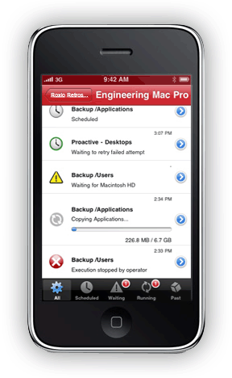
Retrospect app for iPhone
New! Retrospect app for iPhone and iPod Touch allows you to log in one or more Retrospect 8 servers and easily monitor their backup and restore activities over a Wi-Fi or 3G network connection.
Connects via TCP/IP over a Wi-Fi or 3G network.
View all activities or filter to show only scheduled, waiting,
running, or past activities.
A dashboard view provides at-a-glance status for all
monitored Retrospect servers.
An activities view provides status icons and progress bars
for currently running activities.
The details view provides full information on each activity,
including source, destination, files copied, time remaining,
and more.
The log view displays the complete Retrospect operations
log for each activity.
Support coming for Retrospect 7.7 for Windows monitoring.

Slide 17
We support our partners
Partnering with our dedicated resellers is our primary go-to-market strategy in meeting customer needs and developing each market segment.
We focus on supporting a mutually rewarding partnership that Accelerates Partner Profitability through:
  Ease of doing business by providing a robust infrastructure and defined rules of engagement
  Progressive Rewards for a partner's incremental revenue attainment and investment in Retrospect
  Access to the broadest portfolio of industry leading storage hardware, software, and services
  Market reach and opportunity development with Retrospect's market leadership
Your success is our success!
Notes:
We support channel, not direct sales, give reward.. Spiffs, deal reg, conference calls, buddy calls, technical help, need help with closing deals
17

Slide 18



Additional resources
www.retrospect.com/support: Additional free on-line resources
Free video based product training
  Knowledgebase
  Forums
  Sales Hotline: 888-376-1078
  Questions, quotes
sales@retrospect.com
Con call requests, questions, quotes
Notes:
18
18

